Slide 1

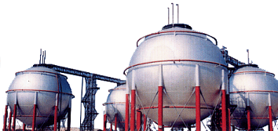
CÔNG TY TNHH VinaLPG
VinaLPG Co., Ltd
Add: 181, Str Cao Thắng, Dist. 10, HCM Vietnam
Tel: 02862 747 789
Email: info@vinalpgas.com.vn

Slide 2
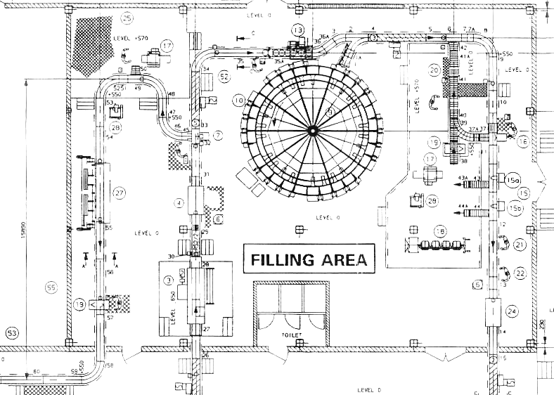

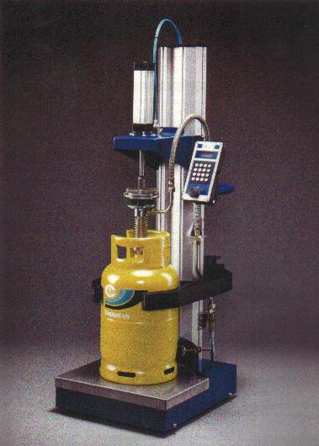
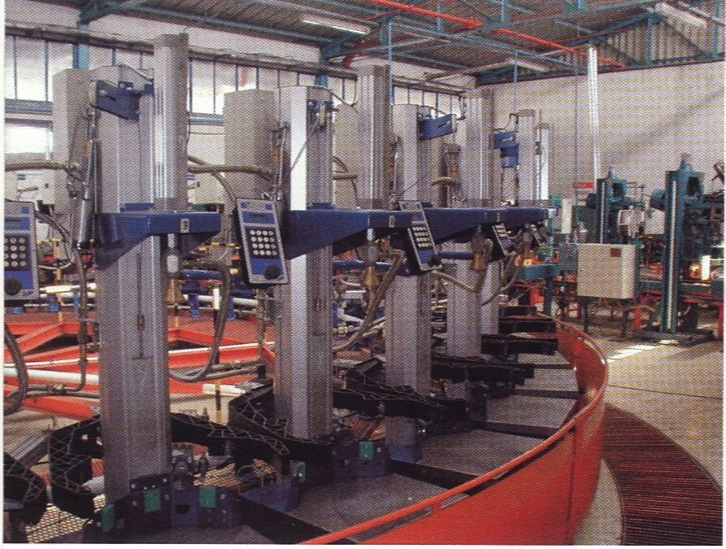
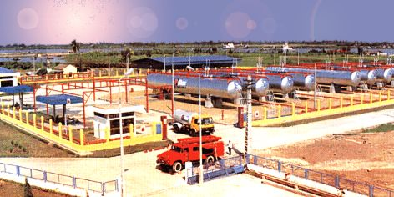
Provide total solution to gas terminal
and plant requirement.
Over 20 years experience on building of
LPG bottling plant.Including total turnkey
project or supply, installation and
commission of complete plant Equipment.
Total Solution for customer need…
We supply from a single piece of equipment to complete plant
including storage tank equipment, flow measuring, filling equipment,
Pipes, fitting and valve, fire safety and gas monitoring system….etc

Slide 3
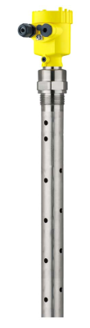
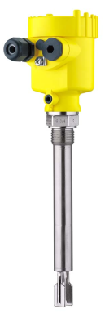
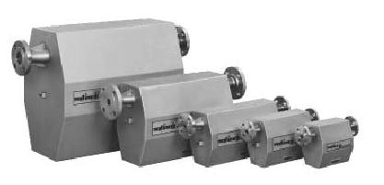
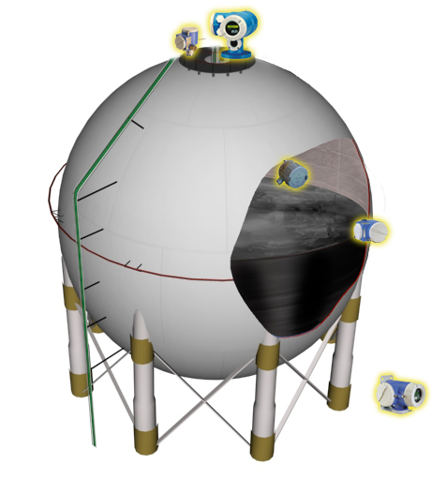
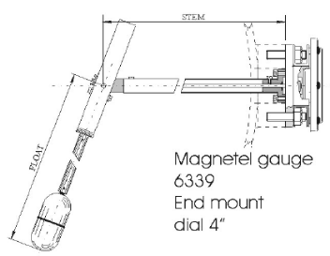
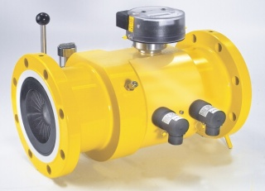
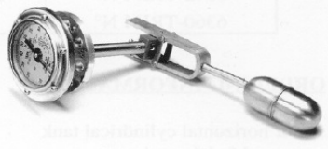
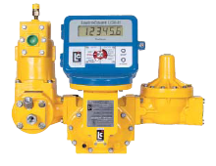
Measuring Equipment.
We provide solution for measuring including liquid level,
flow, temperature, pressure monitoring in your terminal.
Including LPG, Industrial Gases, Diesel and Petroleum ..etc
Level gauges
Coriolis mass meter
Sphere tank measuring
Proservo
Prothermo
Turbine meter
Spot Temperature
Pressure
PD meter
Promonitor

Slide 4
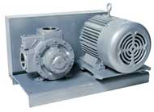
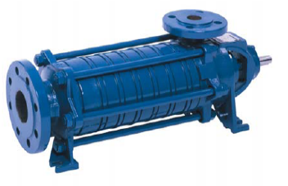

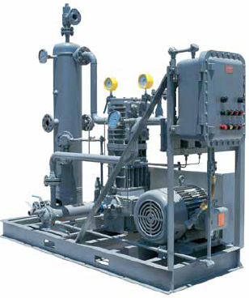
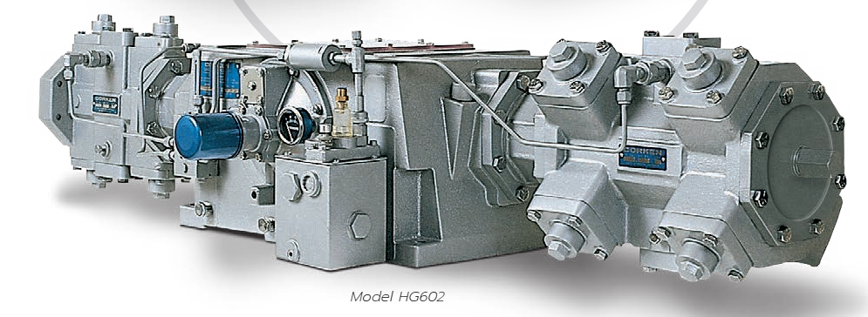
Liquid Transfer Pump and Compressor system.
VINA LPG provide solution for Liquid transfer requirement
Including LPG, Industrial Gases (N2, Ammonia), Diesel and Petroleum ..etc
VINA LPG experience on supply installation and maintenance
of pump and compressor. We can help in selection of pump
and compressor for each application in the plant.
We ensure your plant operation are the most efficient
and beneficial One.
Compressor for ship unloading

Slide 5
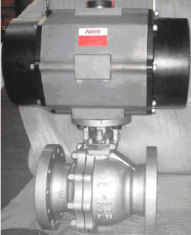
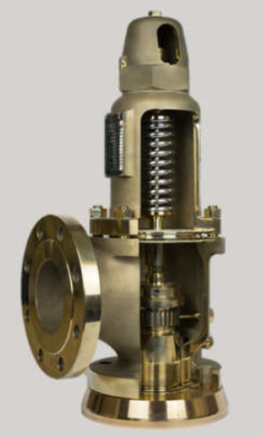
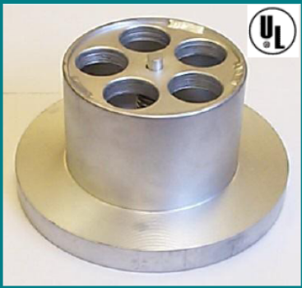
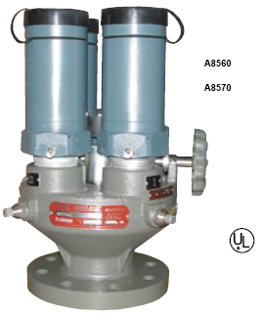
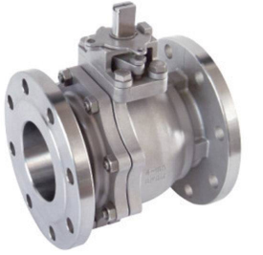
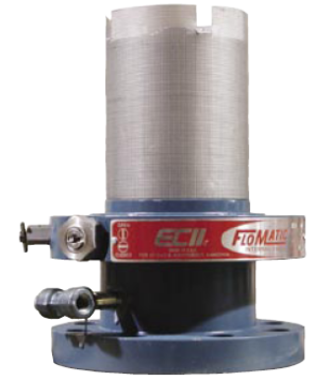
Safety Equipment for Storage tank
Our safety equipment including:
Pressure relief valve (PRV), Emergency shut off valve (ESV),
Excess flow valve (EFV)…etc.
Rofi ESV
Broady
PRV
Rego EFV
Rego PRV
Internal valve

Slide 6
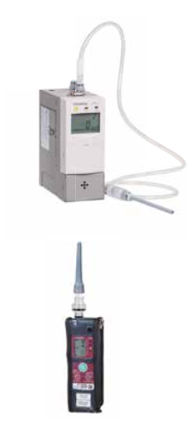
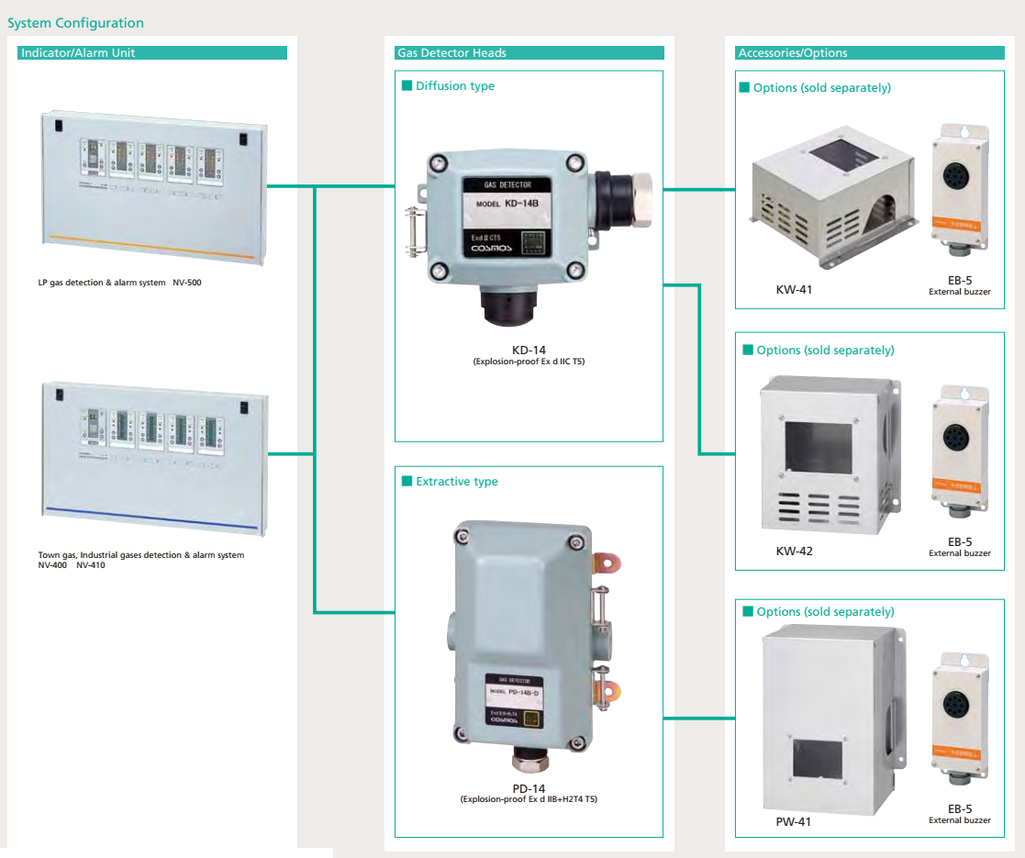
Safety Equipment
Gas leak detecting equipment from portable detection to
multi points detecting system.
For Methane, LPG, CO….etc
Portable Gas detector
System configuration

Slide 7
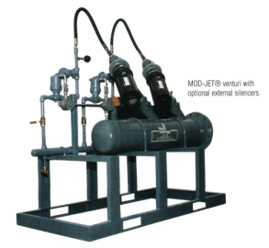
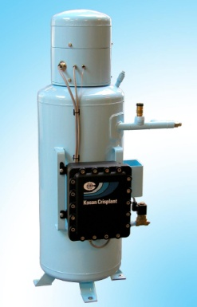
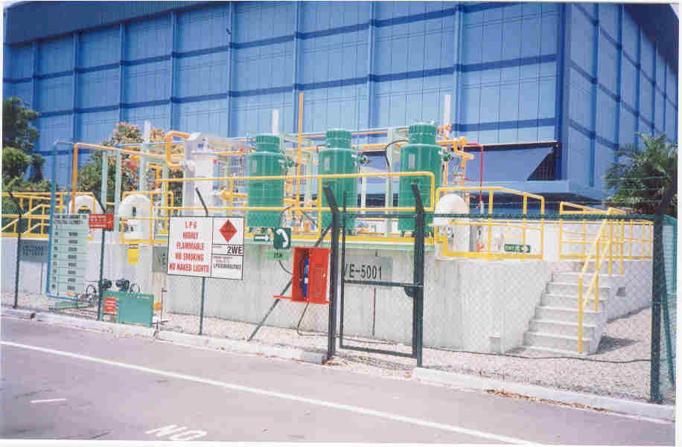
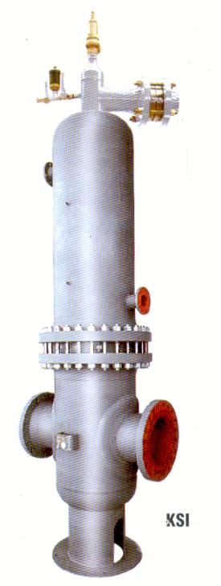
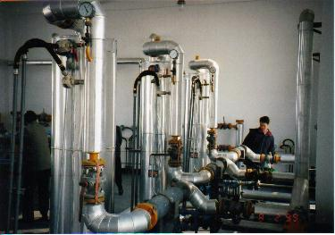
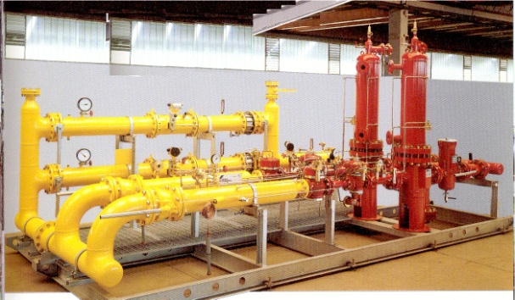
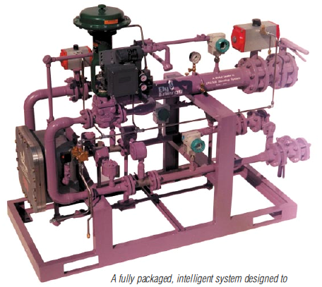
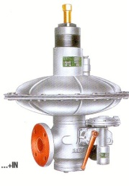
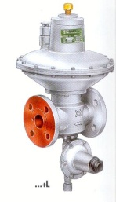
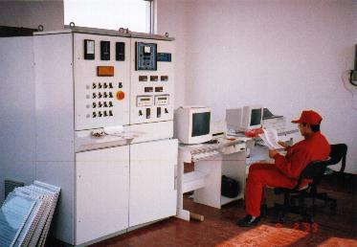
Industry and Housing Estate
Gas Supply System.
VINA LPG have wide range of related product on gas reticulation system.
. LPG reticulation system related product including vaporizer, regulator,
water heater….etc.
. LPG/air mixing system design for industry and housing estate which
prepare for future natural gas line supply.
. Natural gas regulating station, metering station….etc.
The strategy of the company has focus on developing new system
together with our customer.
Our widespread network of sales and contact around the world,
able us to gather professional in different field to satisfy
customer need.

Slide 8
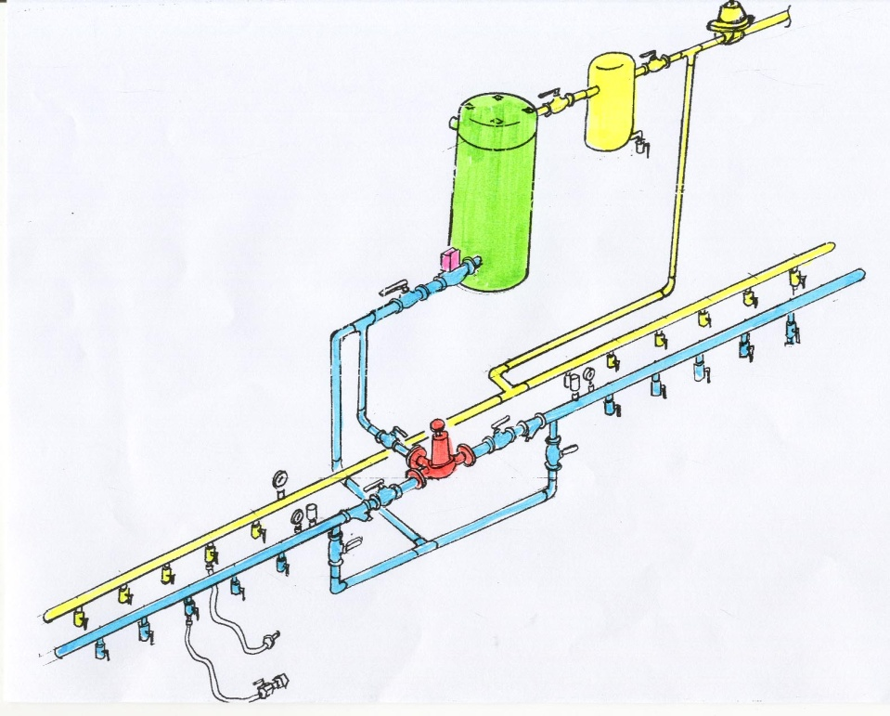
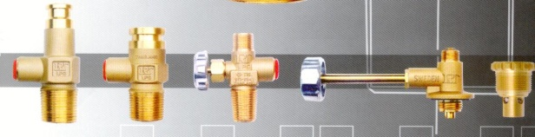
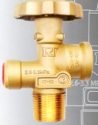
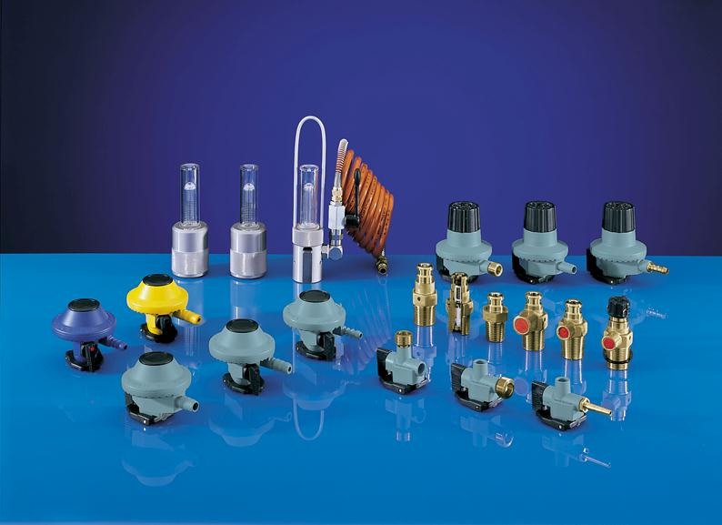
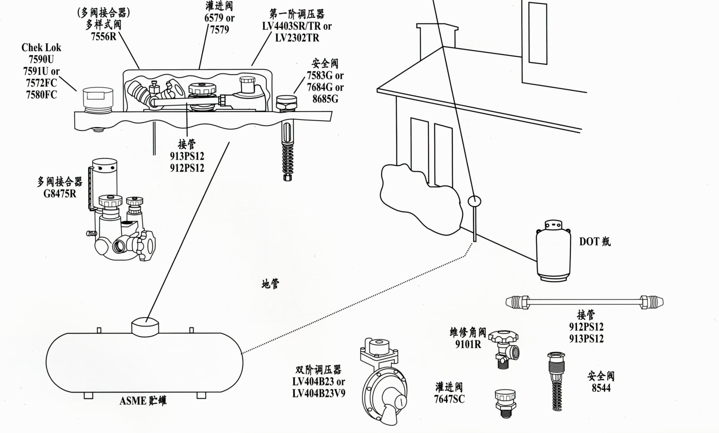
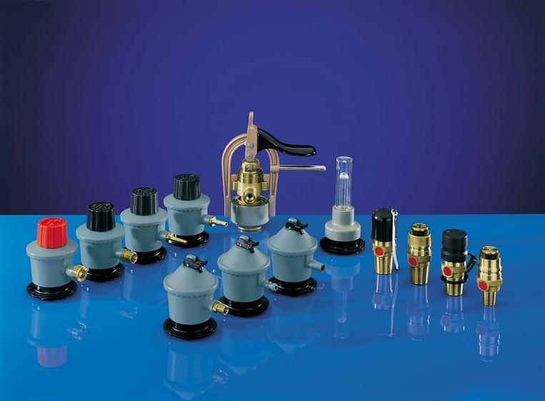
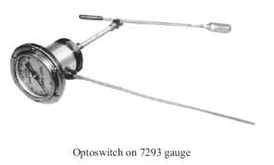
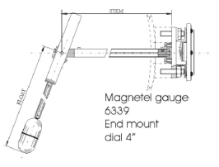
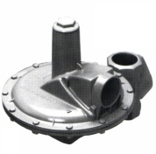
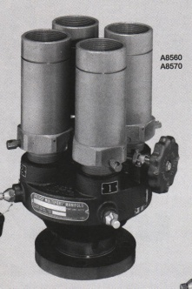
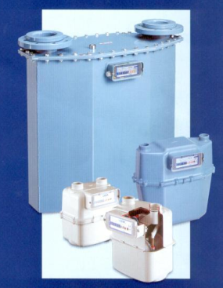
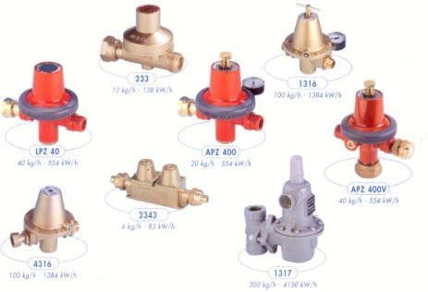
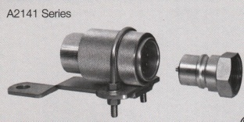

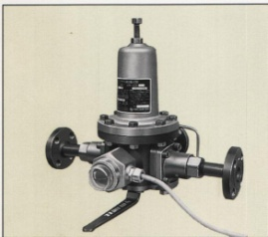

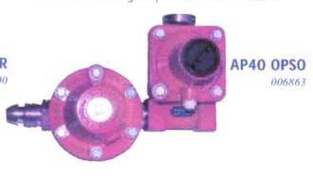
Accessories..
Tank fitting, Industrial and Domestic products.
Total Solution for customer need……………..
To enable us to achieve total solution, VINA LPG are also supply
Tank fitting like Rego safety relief valve, emergency shut off valve
Break away coupling …etc.
Cylinder valve from Comap France, SRG Germany or RT Thailand
House hold product including SRG domestic regulator,
Comap domestic regulator, flow meter ……etc.
We believe in serving our customer from one item to a complete
Plant equipment.
Nothing are too small for us.

Slide 9




VINA LPG Integrated Supplier
VINA LPG is an integrated engineering and supplier, we management your project and ensure in time completion of your project.
Complete LPG terminal
Fire water
pump

Slide 10













VINA LPG CO., LTD
Total Solution cater to customer need………
Add: 181, Str Cao Thắng, Dist. 10, HCM Vietnam
Tel: 02862 747 789
Email: info@vinalpgas.com.vn

Slide 11

LPG TERMINAL

Slide 12




JETTY
COMPOSITE HOSES
BREAK AWAY COUPLING
MASS FLOW METER

Slide 13



Sphere tank measuring
Proservo
STORAGE TANK
Prothermo
SAFETY RELIEF
VALVE
LEVEL GAUGE
Spot Temperature
Pressure
EXCESS FLOW
VALVE
Promonitor
EMERGENCY
SHUT OFF
VALVE

Slide 14


VANE PUMP
SIDE CHANNEL PUMP
COMPRESSOR

Slide 15



DP MATER
MASS METER

Slide 16





LPG TERMINAL
LOADING ARM
PULL AWAY VALVE
LOADING ARM
ESV

Slide 17

LPG FILLING
Hazardous Area
Filling Carousel
Cylinder
Inspection &
Registration
Valve Orientation Unit
Non Hazardous Area
Check Scale
Leak Detector

Slide 18


Equipments For Ship

Slide 19





Equipment For LPG Ship

Slide 20

Equipment For LPG Ship

Slide 21


Equipment For LPG Ship

Slide 22

SEMINAR

Slide 23

SEMINAR

Slide 24

TRAINING

Slide 25

TRAINING

Slide 26

Factory Visit

Slide 27

Factory Survey

Slide 28




Installation

Slide 29




Maintenance

Slide 30

Corken mobile evacuation skids

Slide 31



Maintenance

Slide 32




Maintenance

Slide 33



Maintenance

Slide 34
Vina LPG CO., Ltd
Total Solution cater to customer
need………
Add: 181, Str Cao Thắng, Dist. 10, HCM Vietnam
Tel: 02862 747 789
Email: info@vinalpgas.com.vn

